Slide 1


Case Study 1.0 ConocoPhillips
Andreja Duric, Maximilian Kuttner, Robin Kofer, Matteo Lerda, Santiago Orantes, Dominic Wisak

Slide 2
Outline
Book and Market Leverage
Key Ratios
Market Proxy
Arithmetic vs Compounding return analysis
Return Volatility
Rolling Volatility and Correlation

Slide 3
Book and Market Leverage

Slide 4

Key ratios
Year | 2015 | 2016 | 2017 | 2018 | 2019 | 2020
Gross Profit Margin | 57,97% | 57,82% | 57,14% | NA | NA | NA
Net Profit Margin | -14,98% | -15,26% | -2,94% | 16,61% | 20,72% | -14,44%
P/E Ratio | 0,00 | 0,00 | 0,00 | 10,45 | 9,25 | 0,00
Market-to-Book Ratio | 0,68 | 0,87 | 1,09 | 1,19 | 1,20 | 0,88
Interest Coverage | 8,87 | 5,44 | 3,38 | -12,57 | -11,24 | 4,90
ROE | -11,05% | -10,26% | -2,78% | 19,51% | 20,51% | -9,05%
ROA | -4,54% | -4,03% | -1,17% | 8,94% | 10,20% | -4,31%
Year | 2015 | 2016 | 2017 | 2018 | 2019 | 2020
CFOA | 7.572 | 4.403 | 7.077 | 12.934 | 11.104 | 4.802
CFFA | -1.429 | 764 | -12.356 | -9.359 | -5.229 | -2.708
CFIA | -8.655 | -3.859 | 7.762 | -3.843 | -6.618 | -4.121
(in millions, dot used as thousand separator)

Slide 5
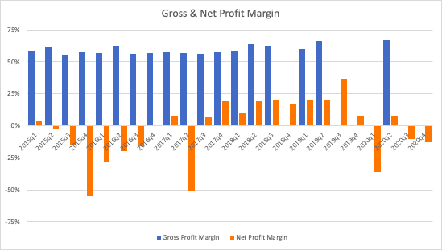
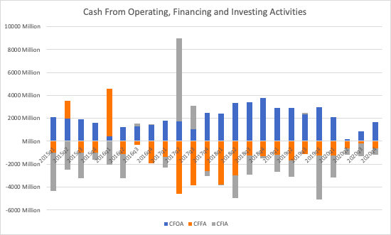
Key ratios- Quarterly Data

Slide 6
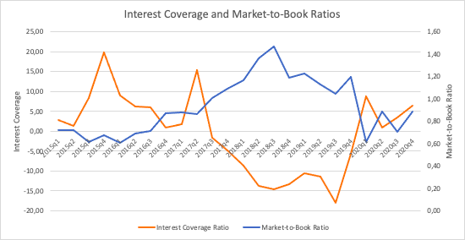
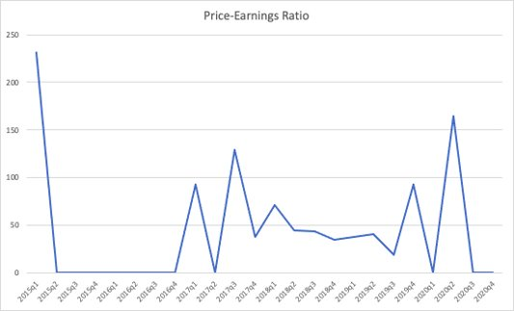
Key ratios- Quarterly Data

Slide 7
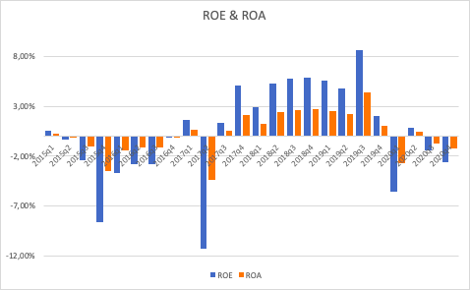
Key ratios- Quarterly Data

Slide 8
Dividends
Decleration Date | Record Date | Payable Date | Amount
10/09/20 | 10/19/20 | 12/01/20 | $0.43
07/08/20 | 07/20/20 | 09/01/20 | $0.42
04/30/20 | 05/11/20 | 06/01/20 | $0.42
02/04/20 | 02/14/20 | 03/02/20 | $0.42
10/07/19 | 10/17/19 | 12/02/19 | $0.42
07/11/19 | 7/22/19 | 09/03/19 | $0.305
05/01/19 | 05/13/19 | 06/03/19 | $0.305
01/30/19 | 02/11/19 | 03/01/19 | $0.305
10/05/18 | 10/15/18 | 12/03/18 | $0.305
07/11/18 | 7/23/18 | 09/04/18 | $0.285
05/04/18 | 05/14/18 | 06/01/18 | $0.285
02/01/18 | 02/12/18 | 03/01/18 | $0.285
10/06/17 | 10/16/17 | 12/01/17 | $0.265
​07/12/17 | ​07/24/17 | ​09/01/17 | ​$0.265
05/05/17 | 05/15/17 | 06/01/17 | $0.265
​01/31/17 | ​02/14/17 | ​03/01/17 | ​$0.265
​10/06/16 | ​10/17/16 | ​12/01/16 | ​$0.25
​07/13/16 | ​07/25/16 | ​09/01/16 | ​$0.25
05/10/16​ | ​05/20/16 | ​06/01/16 | ​$0.25
​02/04/16 | ​02/16/16 | ​03/01/16 | ​$0.25
Note: Ex-dividend date is the second business day prior to the record date. Dividends are paid to shareholders of record on the record date. Shares must be purchased before the ex-dividend date to settle by the record date and be entitled to receive the dividend.

Slide 9
Share Repurchases
Announcement Dates:
November 10, 2016
March 29, 2017
February 1, 2018
February 2020
Year | Amount in MM $
2020 | 892
2019 | 3.500
2018 | 2.999
2017 | 3.000
2016 | 126
Sum | 10.517

Slide 10
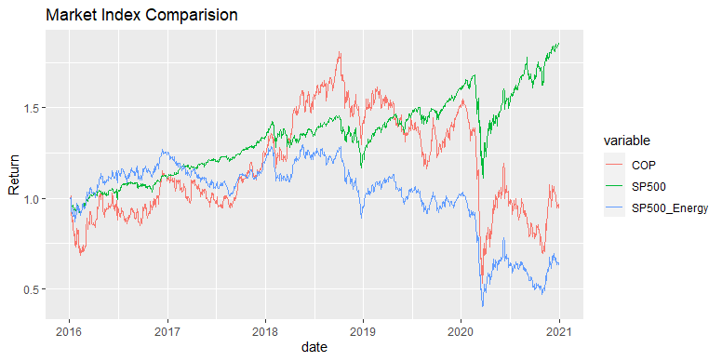
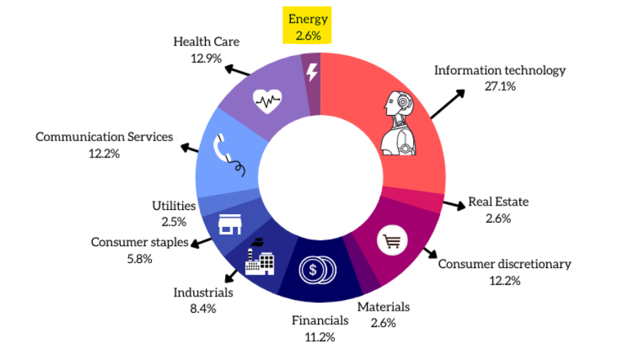
Market Proxy
S&P 500 Sector Weightage (2021-07)

Slide 11
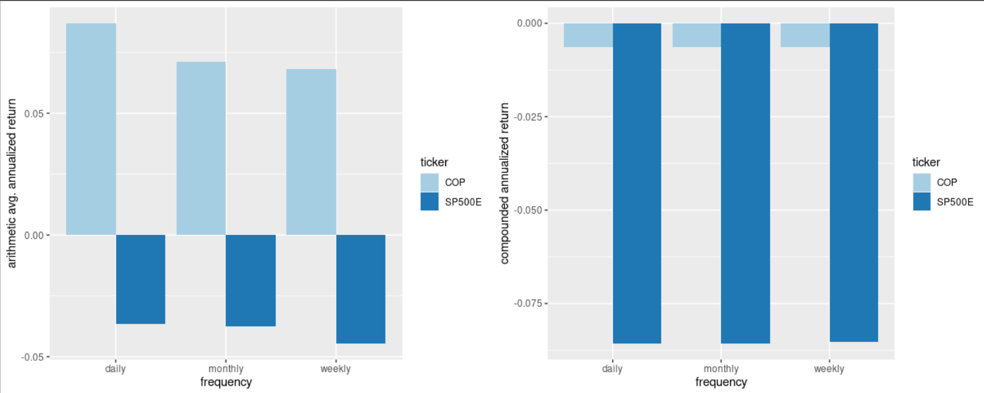
Arithmetic vs Compounding return

Slide 12
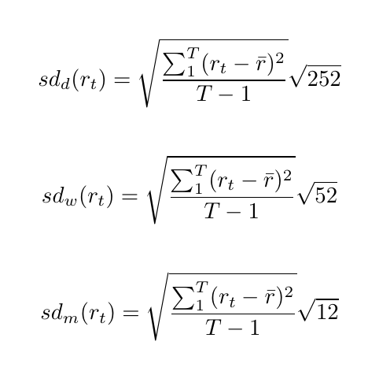
Return Volatility
Average annualized return volatility for 2016-01-01 to 2020-12-31
Frequency | Volatility - COP | Volatility - SP500E
Daily | 0.4311236 | 0.3237043
Weekly | 0.3813763 | 0.293942
Monthly | 0.3986449 | 0.3178467

Slide 13
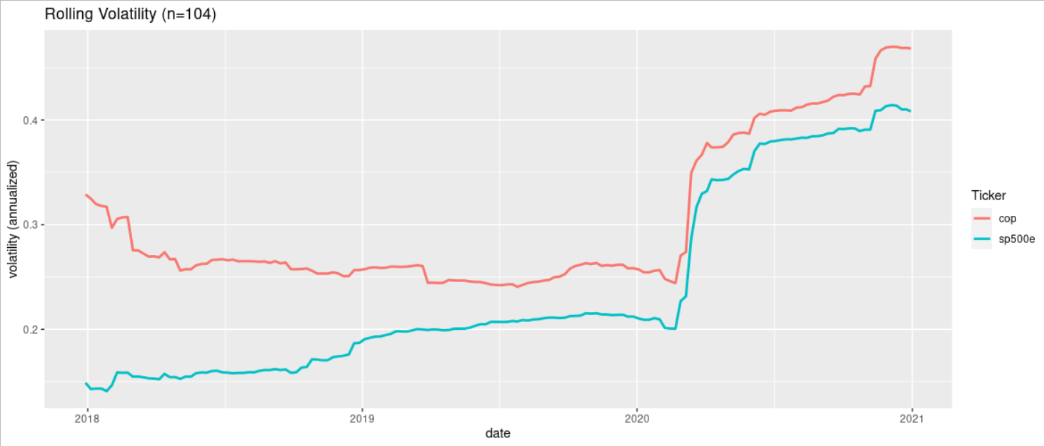
Rolling Volatility

Slide 14
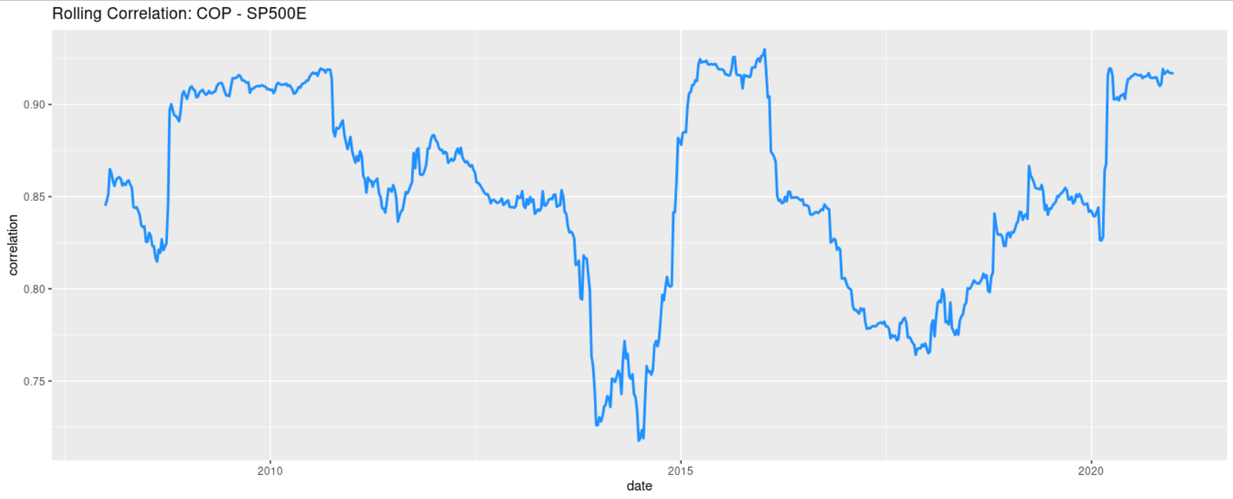
Rolling Correlation

